Slide 1
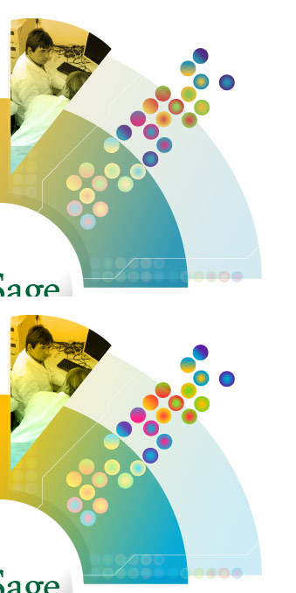
Sage Bionetworks Mission
Sage Bionetworks is a non-profit organization with a vision to create a “commons” where integrative bionetworks are evolved by contributor scientists with a shared vision to accelerate the elimination of human disease
Building Disease Maps
Data Repository
Commons Pilots
Discovery Platform
Michael Kellen
Director of Technology

Slide 2
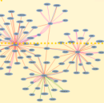
Need: Community-based analysis is required to build accurate models of disease
?
?
Clinical
Improvement
Data curation
Statistical QC
Genomic analysis
Network construction
Network analysis
Data mining
Validation
Within the analytical community:
Quality assessment of data, tools and models
Reproducibility of models
Reusability of data
Validation of models across multiple disease models and patient subtypes
Across the field of biology:
Validation of model predictions in experimental/clinical setting
Accelerated pace towards improved therapeutic development

Slide 3
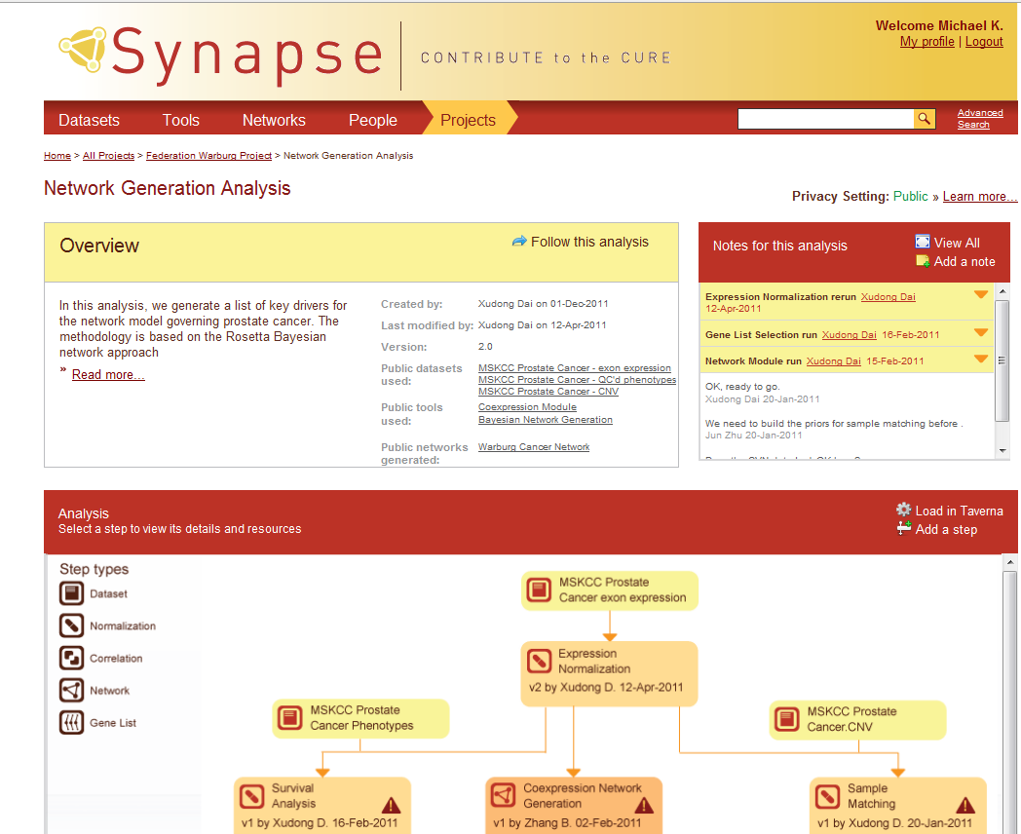
Watch What I Do, Not What I Say
Real-time tools to track data analysis projects

Slide 4
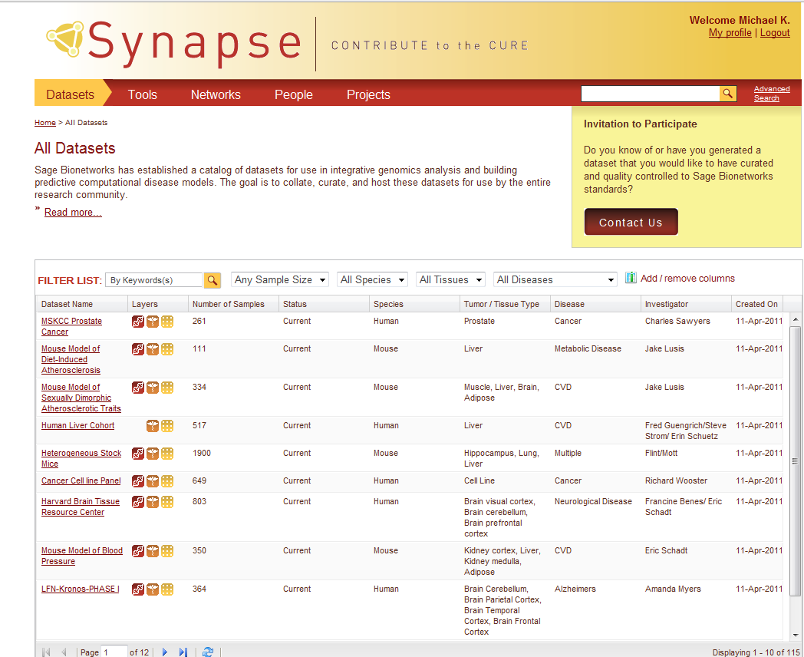
Reduce, Reuse, Recycle
A Repository of Data, Tools, and Models

Slide 5
Most of the People You Need to Work with Don’t Work with You
An online community to connect people and projects

Slide 6
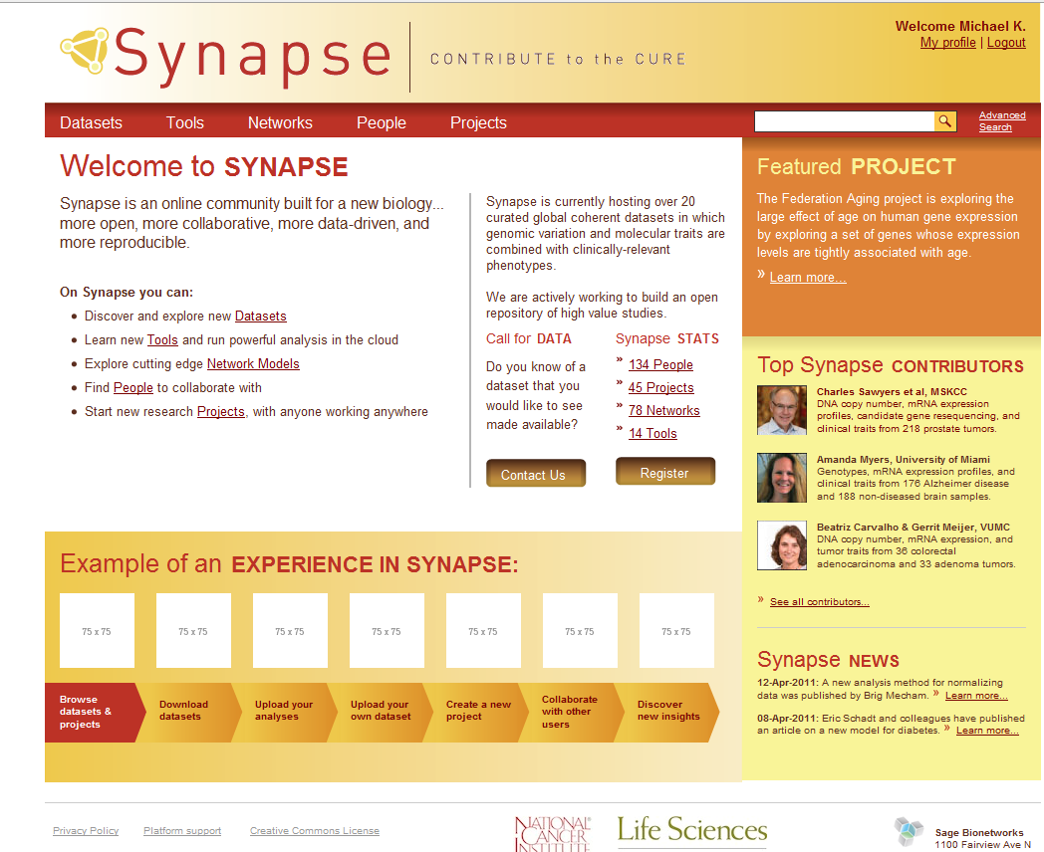
My Other Computer is Amazon
Cloud-based data stores and compute resources

Slide 7
Do: What will the Synapse Platform and Sage Commons Enable?
Development of Robust, Reproducible, and Reusable analytical methods
Integration of Data, Tools and Methods from across community
Development of a Disease Model Repository
Forum for New Collaborations between technically and geographically distinct scientific groups
Access to Cloud-Compute resources co-located with large-scale data
See also the Platform Vision Document posted on our wiki
Translation of Data to Knowledge to Improved Therapeutic Approaches to Disease: An improved molecular understanding of the causes of disease leading to quicker, more rational and more successful development of new drugs

Slide 8
Synapse Roadmap
Data Repository
Projects and security
R integration
Analysis provenance
Synapse Platform Functionality
Workflow templates
Publishing figures
Wiki & collaboration tools
Integrated management of cloud resources
Social networking
User-customized dashboards
R Studio integration
Curation tool integration
Search
Controlled Vocabularies
Governance of restricted data
Internal Alpha
Public Beta Testing
Synapse 1.0
Synapse 1.5
Future
Q1-2012
Q2-2012
Q3-2012
Q4-2012
Q1-2013
Q2-2013
Q3-2013
Q4-2013
TCGA
METABRIC breast cancer challenge
Predictive modeling workflows
Automated processing of common genomics platforms
40+ manually curated clinical studies
8000 + GEO / Array Express datasets
Clinical, genomic, compound sensitivity
Bioconductor and custom R analysis
Data / Analysis Capabilities

Slide 14
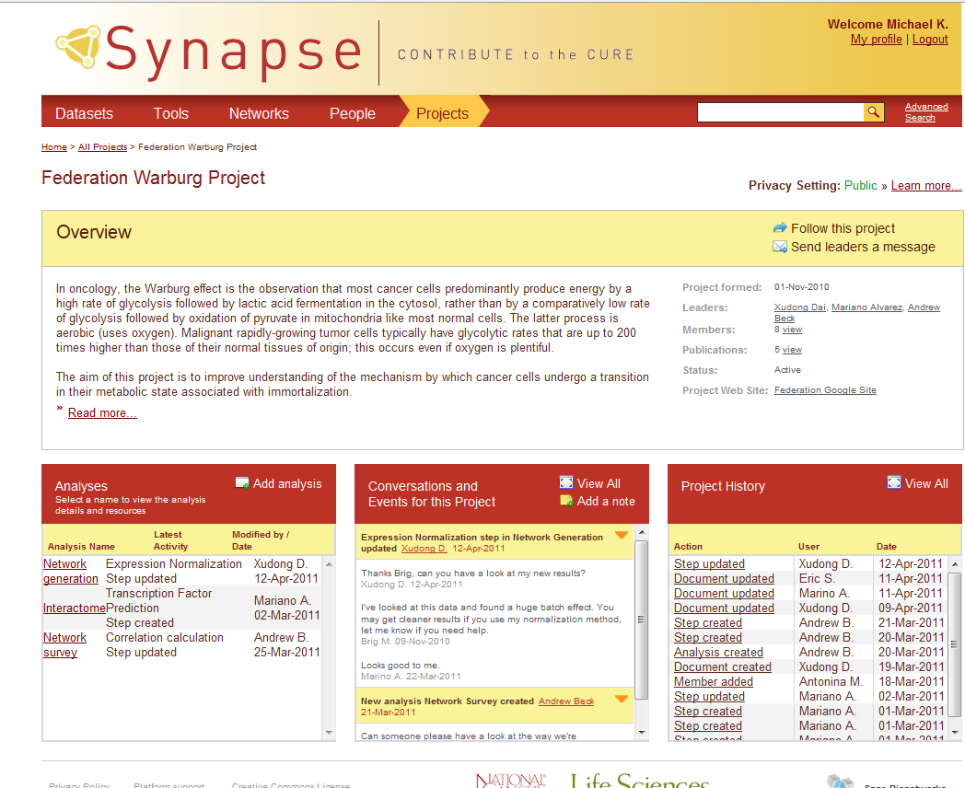

Slide 16
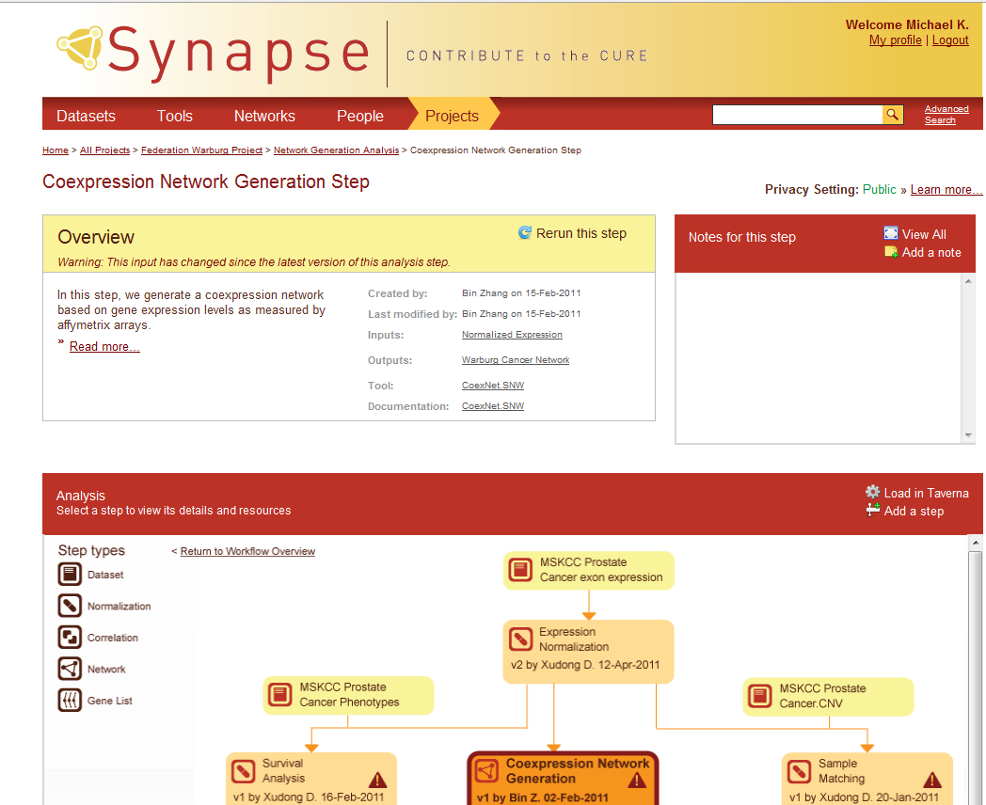

Slide 18
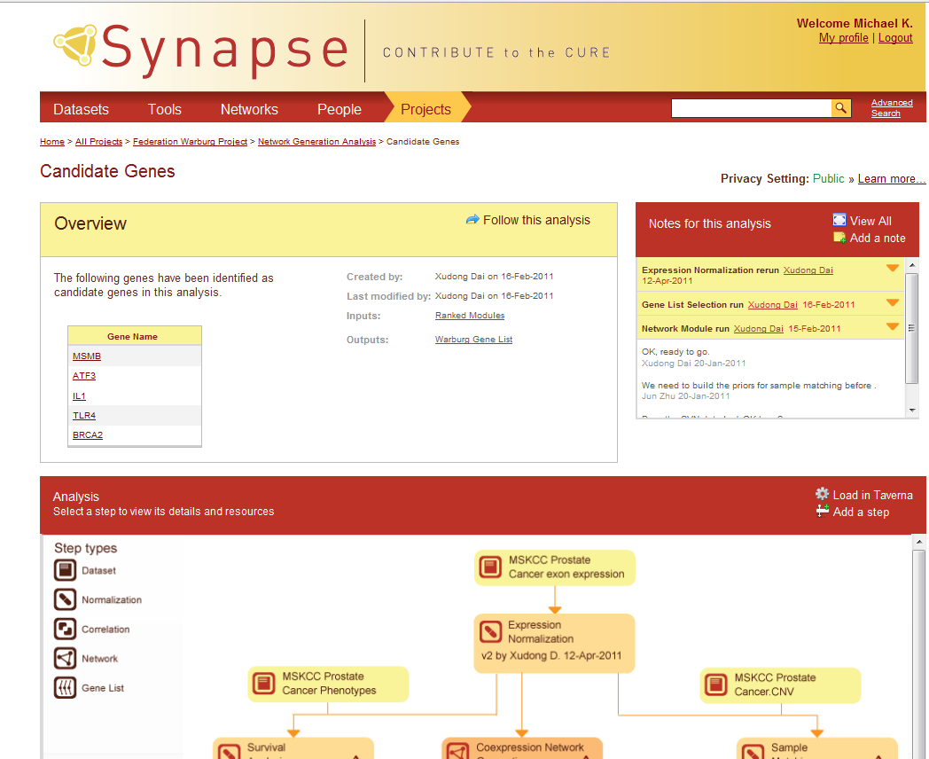

Slide 19
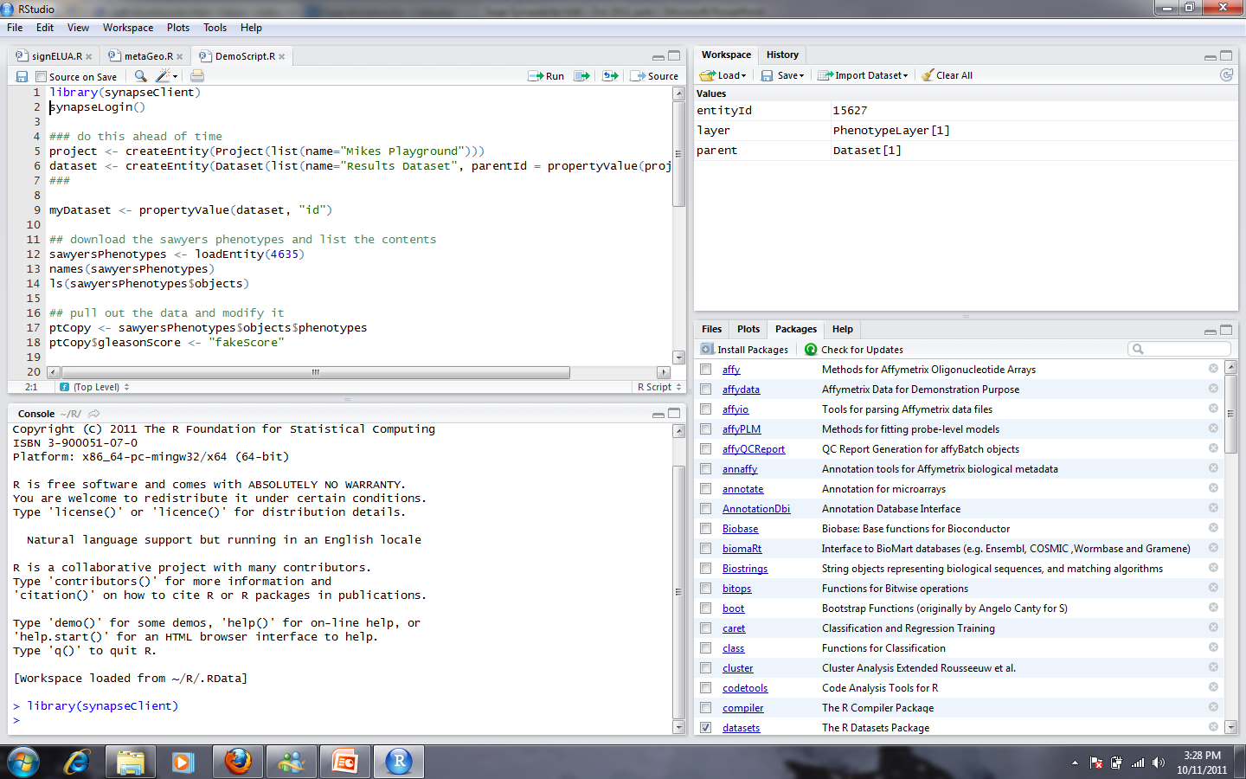

Slide 20
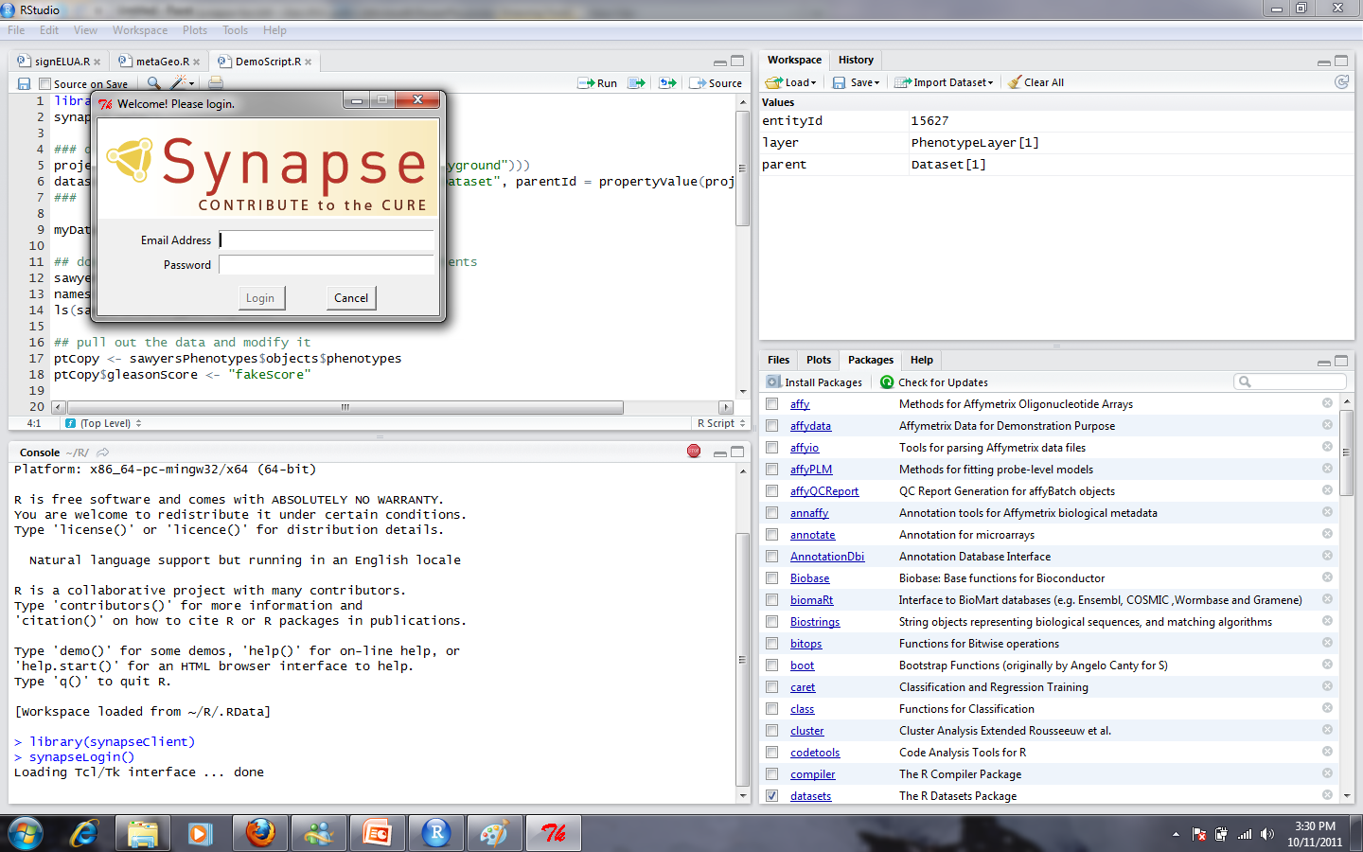

Slide 21
Synapse: Infrastructure for Open Clinical Genomics Research
Watch What I Do, Not What I Say
Reduce, Reuse, Recycle
Real-time tools to track data analysis projects
A Repository of Data, Tools, and Models
Most of the People You Need to Work with Don’t Work with You
My Other Computer is Amazon
An online community to connect people and projects
Cloud-based data stores and compute resources

