Slide 1
Sage Congress 2012 Session 1: Synapse
SHARED
COLLABORATION
SPACE
GITHUB
SYNAPSE
Michael Kellen, PhD
Director of Technology, Sage Bionetworks

Slide 2
“If I have seen further it is by standing on the shoulders of giants”
Sir Isaac Newton

Slide 3
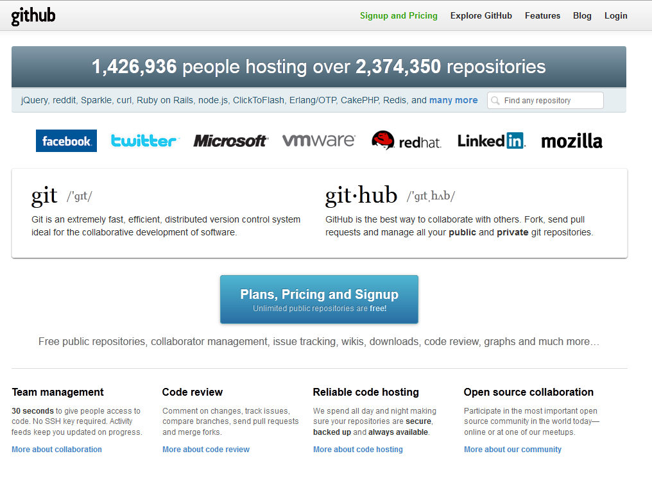
Two approaches to building common scientific and technical knowledge

Slide 4
Journal articles are high-level summarizations of research, written after the fact
Record research progress in real time
“Watch what I do, not what I say”

Slide 5
Finding and using relevant data is wasteful and time consuming
Load public data from anywhere; publish your own contributions
“Reduce, Reuse, Recycle”

Slide 6
You don’t actually know who can help you
Collaborate on line, without organizational boundaries
“Most of the people you need to work with don’t work with you”

Slide 7
Scientific computing requires expensive infrastructure that is difficult to maintain.
Leverage cloud-based data stores and compute resources
“My other computer is a data warehouse”

Slide 8
Current Capabilities
Live Synapse Demo

Slide 9
Synapse Future Directions

Slide 10
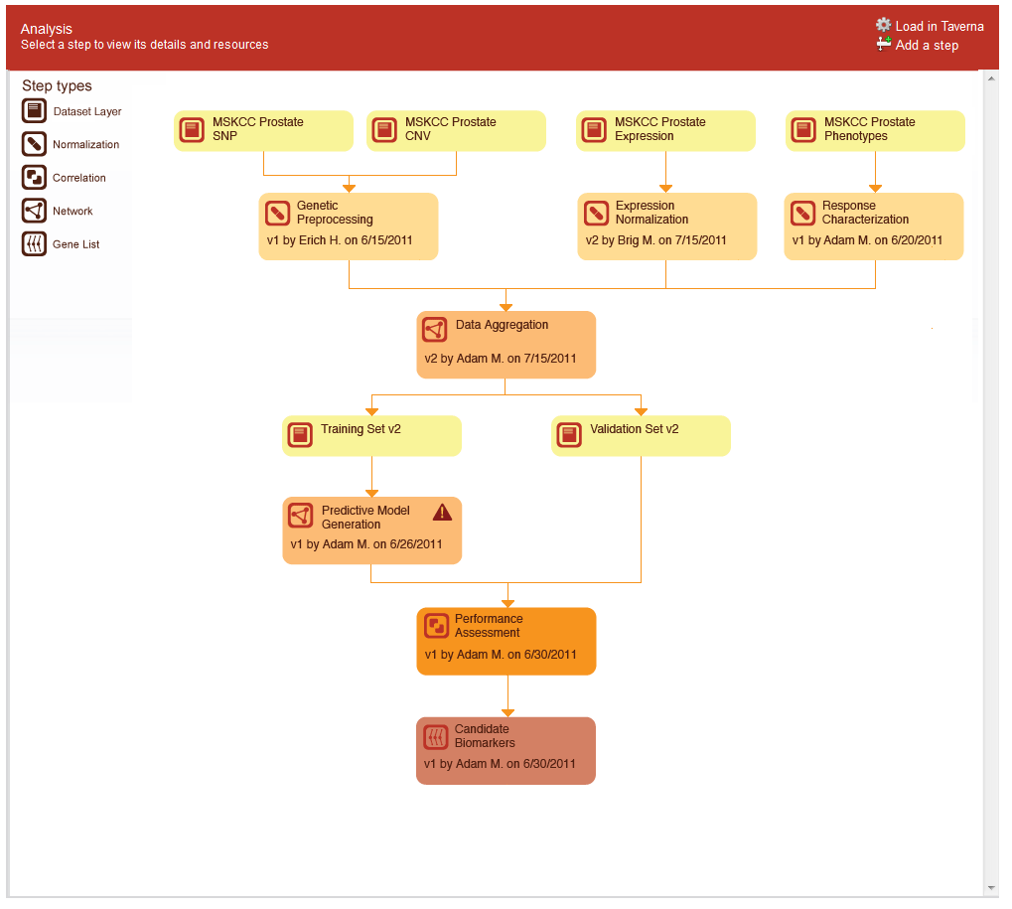
Analysis Records and Visualizations

Slide 11
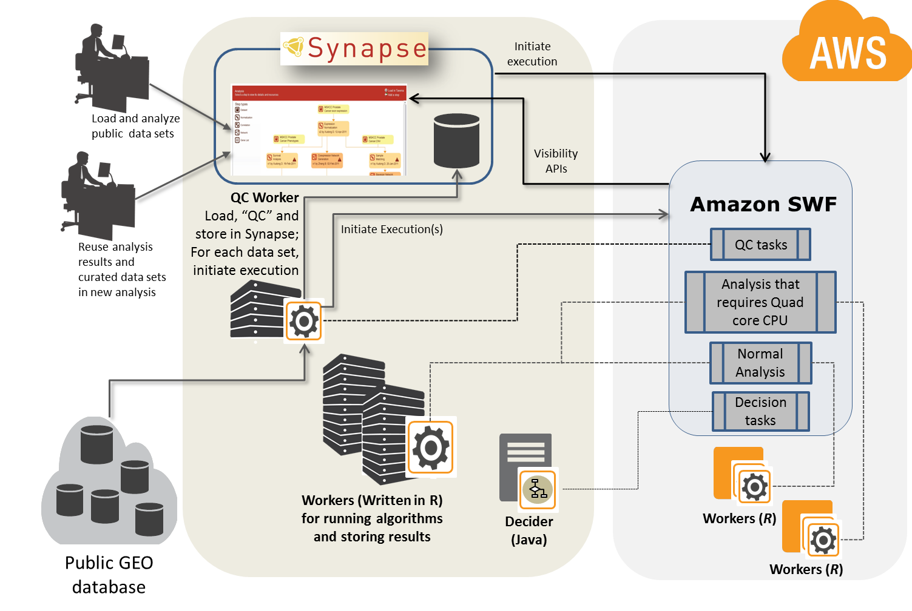
Scalable Analysis Pipelines
Full case study at http://aws.amazon.com/swf/testimonials/swfsagebio/
Notes:
Sage’s Metagenomics workflow makes data from GEO, Array Express, and other public repositories available in a form that facilitates downstream analysis through our Synapse platform. Sage standardizes metadata, removes experimental artifacts, normalizes the data, and formats it for further reuse.
Amazon SWF coordinates each step of the workflow. The actual jobs to process each dataset can run either on our own servers, or Amazon’s.
The record of exactly what the workflow did is stored in Synapse, and made publicly available.
Other researchers can then reuse this public data in new studies.

Slide 12
Additional Data Analysis Tools and Capabilities

Slide 13
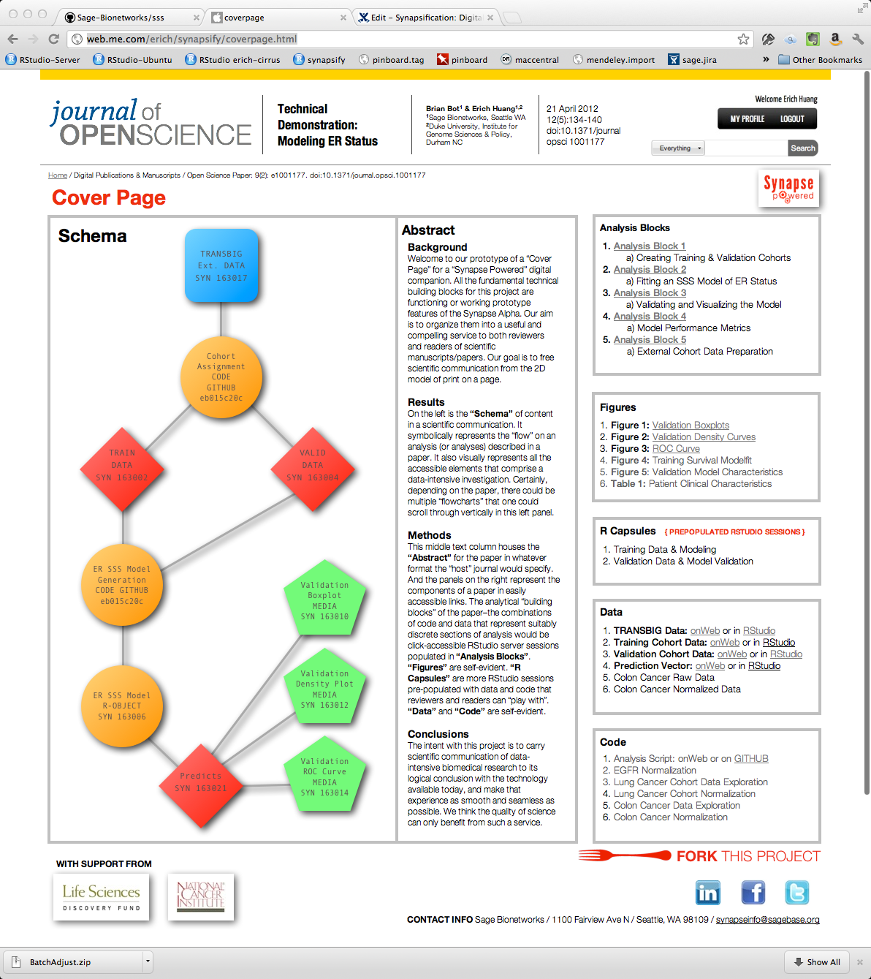
Digital Publication Builder

Slide 14
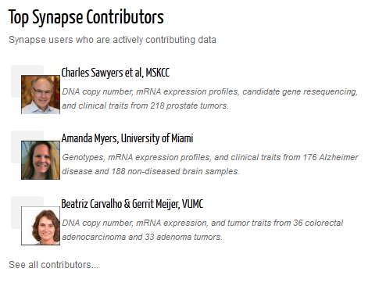
Data Use Tracking and Attribution
Synapse Home Page
Synapse Data Users
14:15 on 3/27/2012 – Eric Schadt downloaded the MSKCC gene expression data contributed by Charles Sawyers at MSKCC
14:14 on 3/27/2012 – Eric Schadt downloaded the MSKCC clinical data contributed by Charles Sawyers at MSKCC
12:30 on 3/27/2012 – Justin Guiney loaded the BCC expression data in R contributed by Anne-Lise Borresen-Dale at Oslo University Hospital
09:20 on 3/27/2012 – Erich Huang added the GSE1234 normalized expression data produced by Brig Mecham to the Breast Cancer Analysis project
more…
Filter By:
User Name
Contributor
Dataset
Filter By:
Disease Area
Type of Data
Sort By:
Contributor
Contributing Organization
Accessed by 26 Synapse users. See who
Accessed by 23 Synapse users. See who
Accessed by 21 Synapse users. See who

Slide 15
Synapse Roadmap
Data Repository
Projects and security
R integration
Analysis provenance
Synapse Platform Functionality
Workflow templates
Publishing figures
Wiki & collaboration tools
Integrated management of cloud resources
Social networking
User-customized dashboards
R Studio integration
Curation tool integration
Search
Controlled Vocabularies
Governance of restricted data
Internal Alpha
Public Beta Testing
Synapse 1.0
Synapse 1.5
Future
Q1-2012
Q2-2012
Q3-2012
Q4-2012
Q1-2013
Q2-2013
Q3-2013
Q4-2013
TCGA
METABRIC breast cancer challenge
Predictive modeling workflows
Automated processing of common genomics platforms
40+ manually curated clinical studies
8000 + GEO / Array Express datasets
Clinical, genomic, compound sensitivity
Bioconductor and custom R analysis
Data / Analysis Capabilities
Notes:
This needs to become Functionality and Communities.

Slide 16
Current Capabilities
Slide Backups

Slide 17
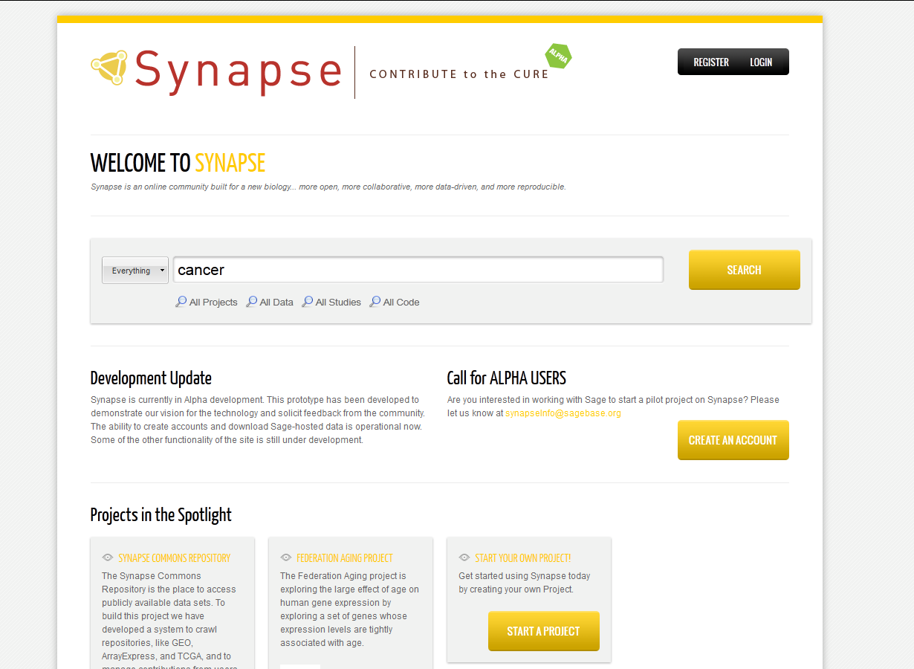

Slide 18
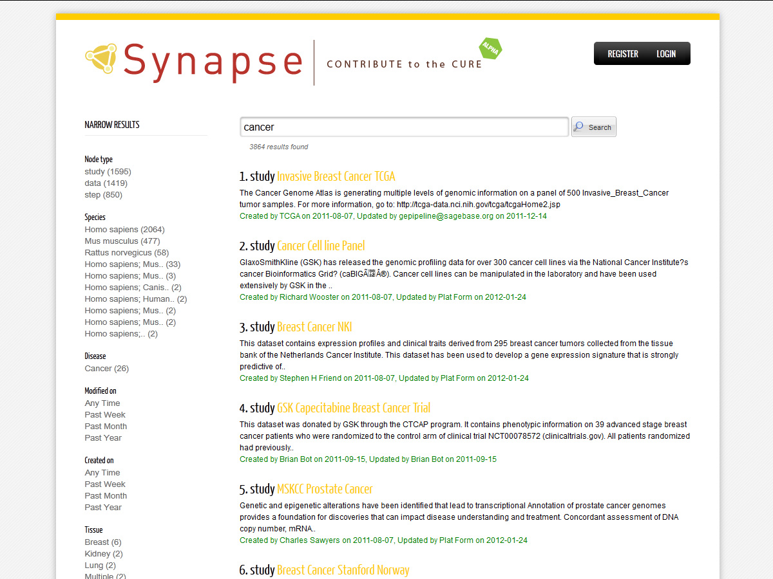

Slide 19
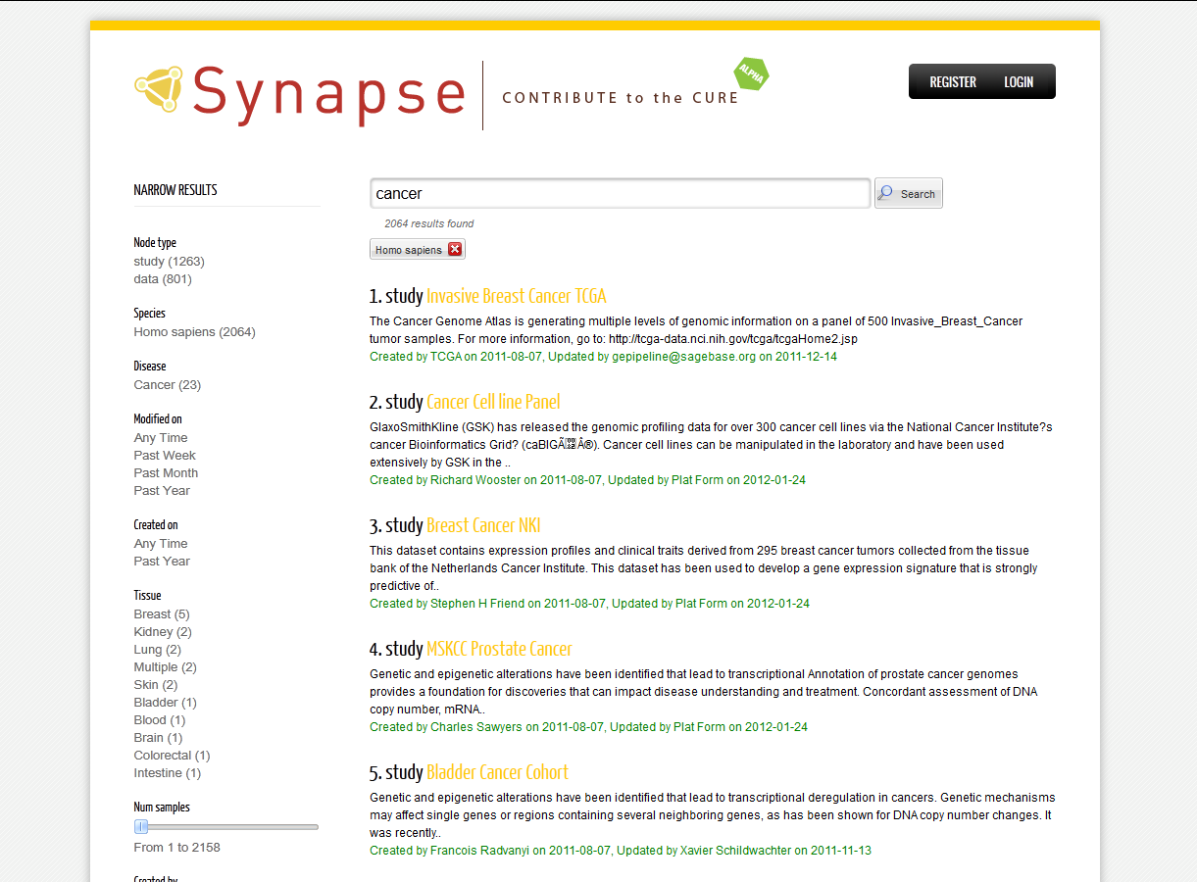

Slide 20
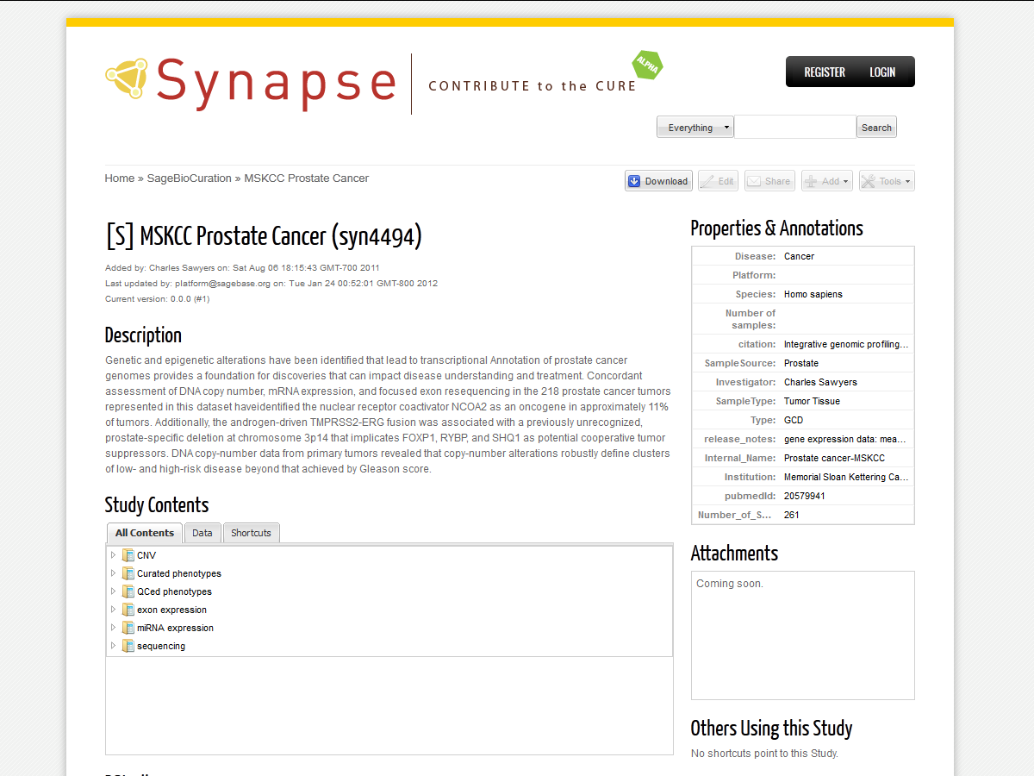

Slide 21
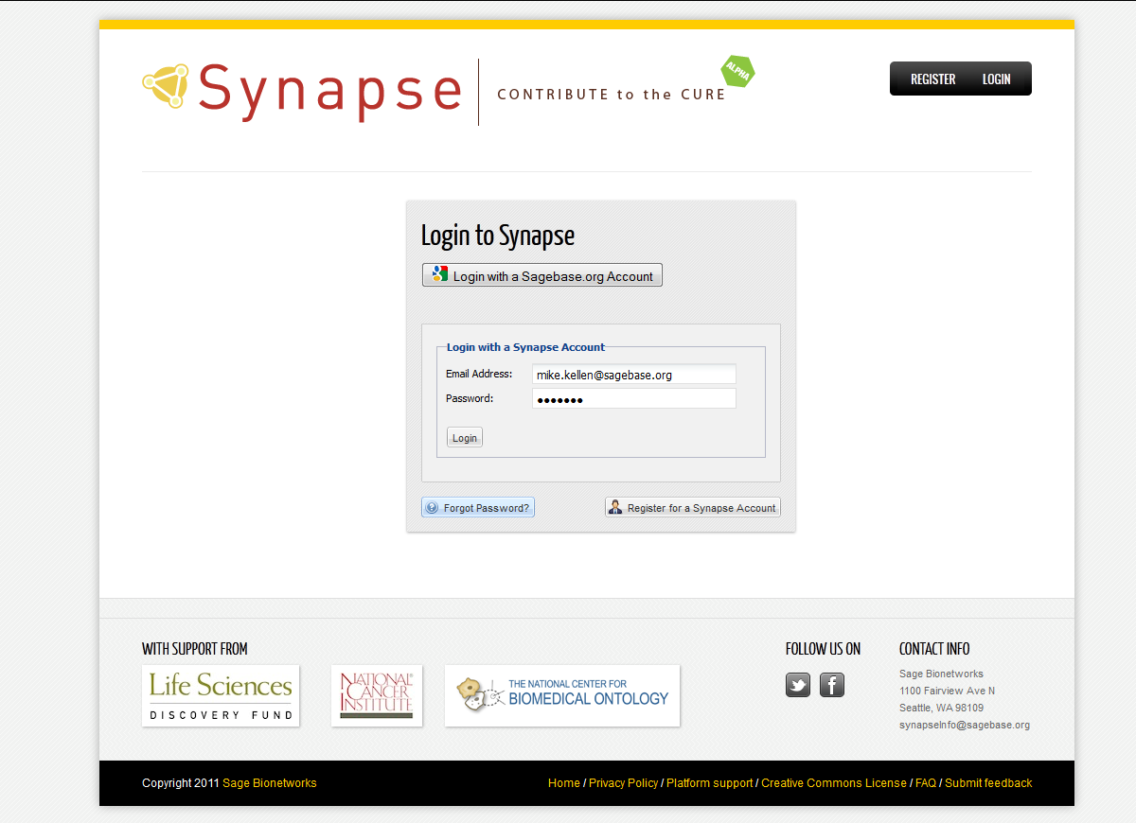

Slide 22
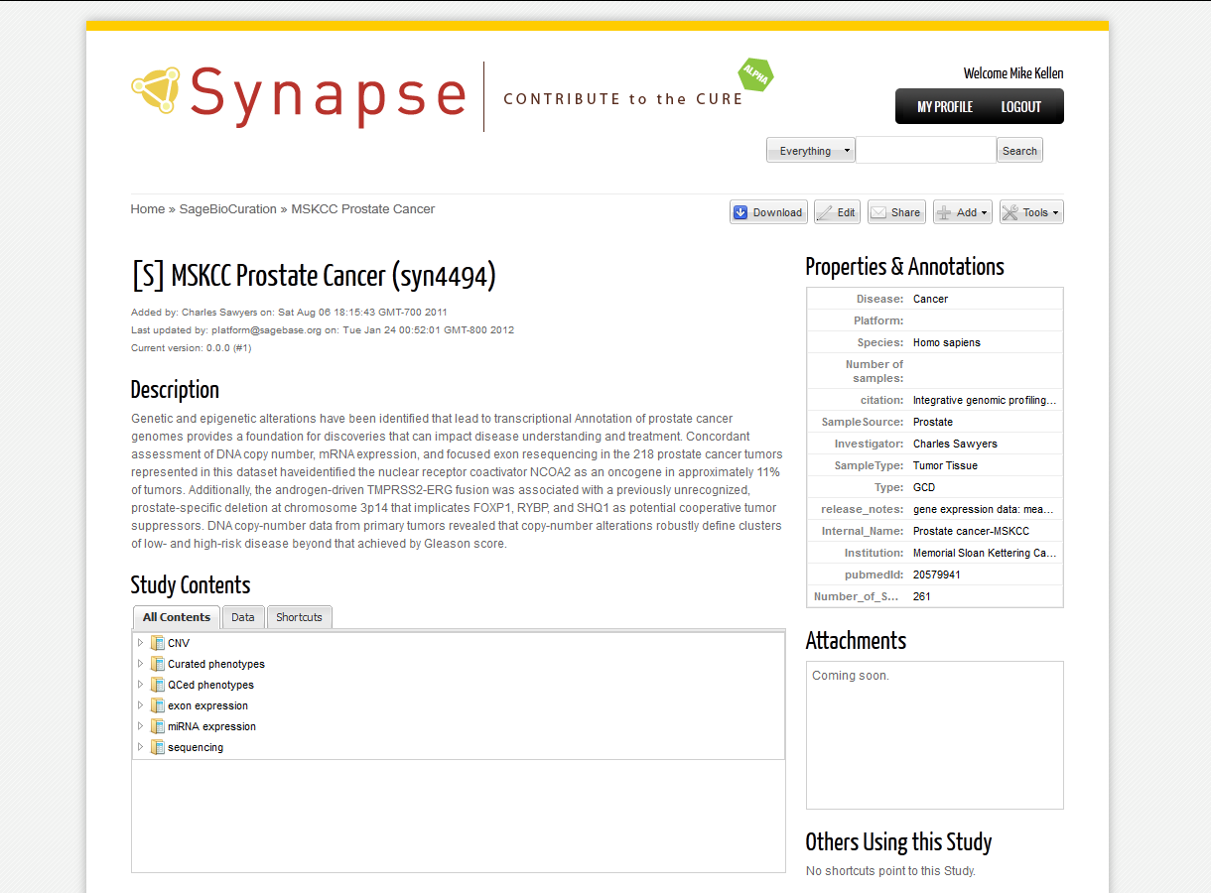

Slide 23
